Slide 1

Live VM Migration
Guide: Anitha H.M
Assistant Professor,
Dept of ISE, BMSCE
Authored By:
Mohammed Yaseen I.M
Syed Mahmood N.A
Tanmay Srinath
Tejasvi Shrivastava
Vinay Pandit

Slide 2

Oh My Cloud!
Cloud computing is proving itself an emerging technology in IT world which provides a novel business model for organizations to utilize software, applications and hardware resources without any upfront investment.
The cloud computing services and infrastructure are mostly owned by a third party called cloud service providers.
As compared to existing IT models, the cloud computing offers many advantages like scalability, flexibility, efficiency and non-core activities.
With the broad development in mobile applications and advancements in cloud computing, a new expansion is being expected in the form of mobile cloud computing (MCC).

Slide 3

Understanding the Everest in Front of US.
Problem Statement: Thoroughly analyse VM migration and its various implementations, and provide an objective overview with benefits and drawbacks.
This presentation provides an overview of VM migration benefits and techniques and discusses its related research challenges in data center environments.

Slide 4

The GOAL…
The objective of this project is to analyse comprehensively the process called VM migration, and highlight its benefits, drawbacks and various implementations.
Using the knowledge from our research papers, we aim to provide the most optimal solution with respect to migration to the Virtual Machines.

Slide 5

Standing on the Shoulder of Giants…
Live Virtual Machine Migration Techniques: Survey and Research Challenges- Divya Kapil, Emmanuel S. Pilli and Ramesh C. Joshi
Cost of Virtual Machine Live Migration in Clouds: A Performance Evaluation -William Voorsluys1 , James Broberg1 , Srikumar Venugopal , and Rajkumar Buyya
A Comprehensive Review of Virtual Machine Migration Techniques in Cloud Computing- Suruchi Talwani, Jimmy Singla
Review on Various VM Migration Techniques-Vinay Katoch,Uday Chourasia
Virtual Machine Migration in Cloud Computing-Pankajdeep Kaur and Anita Rani

Slide 6

And then some more References….
T. Wood et al., “Black-Box and Gray-Box Strategies for Virtual Machine Migration,” Proc. 4th Conf. Symp. Networked Sys. Design & Implementation, 2007
Jie Zheng, Tze Sing Eugene Ng, and Kunwadee Sripanidkulchai. Workload-aware live storage migration for clouds
A.Singh, M. Korupolu, and D. Mohapatra, “Server storage virtualization: integration and load balancing in data centers,”
A Survey of Virtual Machine Migration Techniques in Cloud Computing Sandeep Kaur, Prof. Vaibhav Pandey Department of Computer Science and Engineering, Punjab Institute of Technology, kapurthala Punjab, India
A Virtual Machine Migration Strategy Based on Time Series Workload Prediction Using Cloud Model Yanbing Liu,1 Bo Gong,1 Congcong Xing,2 and Yi Jian.
Energy-aware Virtual Machine Migration for Cloud Computing - A Firefly Optimization Approach Nidhi Jain Kansal · Inderveer Chana

Slide 7

Reasons oh Reasons…
Load Balancing
Server Consolidation
Operation Flexibility
Reduced Overhead
Disaster Management
Increased Fault Tolerance

Slide 8
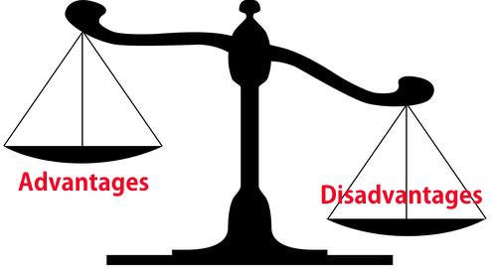
Tick, Tick, Tick….Advantages:
Migration is a good option in cases of some server overload under loaded VMs can be migrated
In cases of Energy or communication purpose VMs are migrated live
For minimizing deficiencies cloud providers can cooperate with each other
VM migration is good technique to avoid the user locked with one vendor using

Slide 9

It’s not a Bed of Roses! Challenges…..
For live migration, the open connections should also be remained alive during migration
The transfer of virtual disk of migrated VM, on the target will be required in case if the storage system of the source data center is not reachable from the target server of VM migration.
Major challenges with VM migration in case of Memory migration, storage data migration and network connection continuity.

Slide 10

How it is done….
Energy Efficient Migration Techniques :Huge amount of data need heavy resource requirement. This consumes a lot of power - about 70% of maximum power consumption even at their low utilization level.
Load Balancing Migration Techniques : A migration technique that distributes the load among different physical server to help in minimizing resource consumption, enhance scalability and avoiding over-provisioning of resources.
Fault Tolerant Migration Techniques: This technique migrates the VM from one physical machine to another even if any part of system fails.

Slide 11

The Towering Two…
The two performance metrics that the users care about most are Downtime and Migration Time.
This is because these metrics deal with service degradation and affect the duration for which the service is available.
The Methods that will be discussed all aim to reduce downtime and migration time in order to improve quality of performance.

Slide 12

Current State of Theory…
Currently, there are two types of virtual machine migration approaches existing in the literature:
one is to combine the upper threshold and lower threshold of the host machine to manage the use of resources
the other is to use the workload threshold of the host machine to predict the trend of its subsequent workloads .

Slide 13
Current State of Theory (Continued)
While the former approach is able to resolve the issue of resource waste inflicted by the static workload balancing strategy, it cannot resolve the issue of aggregation conflict which exits in traditional workload balancing strategies.
On the other hand, the latter approach is able to resolve the issue of “false alarm” virtual machine migrations caused by some transient peak workload values but fails to put into consideration the uncertainty the stochastic nature of the workload values, as well as the combination of both, on host machines.

Slide 14
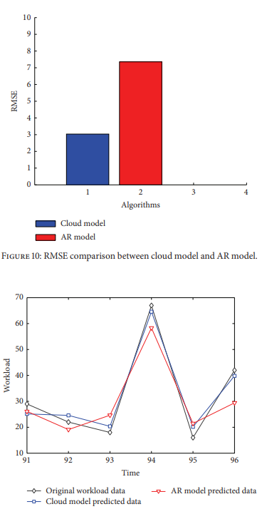
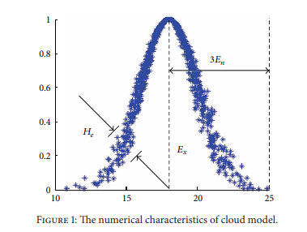
What they did…
The Work Load Prediction Strategy Works as follows:
It first sets up the upper and lower workload thresholds for host machines.
Then it forecasts the future workload tendency of the host machine using cloud theory.
Finally stipulates a migration selection criterion and uses this criterion to select the source host machine, destination host machine, and the virtual machine to perform the desired migration

Slide 15
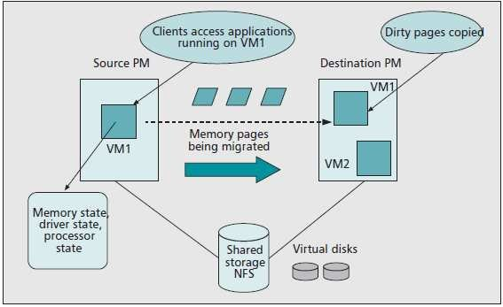
And The Winner Is….
LIVE MIGRATION!!!

Slide 16
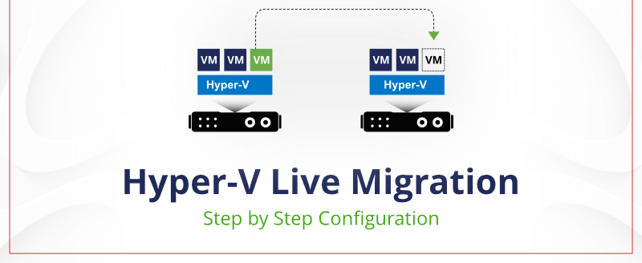
Live Migration – The Beginning…
Live migration involves transferring a running virtual machine across distinct physical hosts. There are many techniques which attempt to minimize the down time and to provide better performance in low bandwidth environment.
Live migration is an extremely powerful tool for cluster and cloud administrator. to improve manageability, OS instances may be rearranged across machines to relieve the load on overloaded hosts.
In order to perform the live migration of a VM, its runtime state must be transferred from the source to the destination with VM still running.

Slide 17

The Crux…
During live migration, the complete contents of the VMs RAM is transferred from the source to the destination host.
To enhance the scalability of physical servers in cloud environment Load balancing migration technique is used.
This technique also provides implementation of fail-over and minimizes the resource consumption.

Slide 18

Dynamics, Dynamics, Dynamics….
The advantage of software virtualization is that VMs can be migrated from one physical host to another.
Live migration is the concept of migrating a VM while it is running and responding to requests.
Since VMs can be relocated while running, live migration allows for better hardware utilization.
Live migration is also a useful tool for administrative purposes.

Slide 19

What Type Are You?
Live Migration fundamentally consists of two types – pre-copy and post-copy live migration.
In Pre-copy migration the state is transferred in the background in a series of iterations while the source VM is running and responding to requests.
Post-copyVM migration is initiated by suspending the VM at the source.

Slide 20
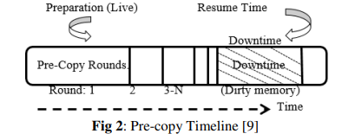
The Before…
The Pre Copy Approach:
In the first round it transfers all the memory pages to destination machine.
Then iteratively copies pages modified in last round.
If some memory pages change (become 'dirty') during this process, they will continue to be re-copied until the rate of re-copied pages is not less than page dirtying rate.
Pre copy has 2 phases-Warm-Up and Stop-and-Copy Phase.

Slide 21
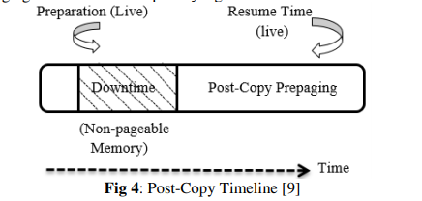
The After…
The Post Copy Approach:
Transfer of memory content after the transfer of process state.
We employ a combination of four techniques to fetch memory pages from the source: demand paging, active push, pre paging, and dynamic self-ballooning (DSB).
Since each page fault of the running VM is redirected towards the source, this technique can degrade performance of applications running inside the VM. However, pure demand-paging accompanied with techniques such as pre-paging can reduce this impact by a great extent.

Slide 22
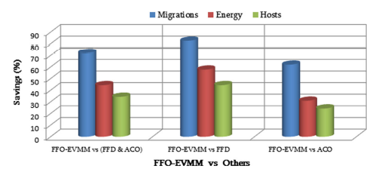
The Law of Efficient Use of Energy…
Energy efficiency has grown into a latest exploration area of virtualized cloud computing paradigm.
The increase in the number and the size of the cloud data centers has propagated the need for energy efficiency.
An extensively practiced technology in cloud computing is live virtual machine migration and is thus focused in this work to save energy.

Slide 23

The Firefly Example
The contribution of the Firefly Model based Live Migration is as follows:
An energy-aware meta-heuristic technique that performs live migration of the VMs from one active node to the other active node.
Making use of a bio-inspired Firefly optimization technique to achieve energy efficiency in cloud data centers.
Maximizing energy-efficiency through the optimum migration of VMs.
Sustained Scalability.
Result : An enhancement in the average energy consumption of about 44.39 % has been attained by reducing an average of 72.34 % of migrations and saving 34.36 % of host.

Slide 24

Adaptation and Evolution…
There is an enhanced LM technique called Adaptive Live Migration to improve load balancing in Virtual Machine Environment .
It has an efficient load balancing framework which reduces a decision generating latency and applies a workload-adaptive approach for minimal downtime.
Following are the steps involved in load balancing strategy:
First it calculates the load corresponding to CPU and memory
After examine the load value, it calculate the total and average utilization of the entire machine.VM live migration will trigger if the value is greater than threshold T.
If migration happened then check node examine history record for similar CPU utilization. If record exist then schedule VM migration by selecting same source and destination

Slide 25

How much does it cost?
Overall, experimental results show that overhead due to live migration is acceptable but cannot be disregarded, especially in SLA-oriented environments.
Results show that, in an instance of a nearly oversubscribed system (serving 600 concurrent users), live migration causes a significant downtime (up to 3 seconds), a larger value than expected.
On the other hand, it has been found the most stringent SLA (99th percentile) can still be met when migrations are performed when the system load is slightly decreased to less concurrent users (500 in our case study).
In conclusion, there is a high potential for live migration applicability in data centers serving modern Internet services.

Slide 26
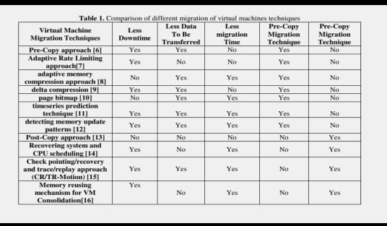
How it all stacks up…

Slide 27

The Culmination…
VM migration can serve as a powerful tool for adjusting workload placement in a dynamic manner to achieve a variety of resource management objectives, including load balancing, server consolidation, improving data and communication locality, reducing energy consumption, as well as supporting mobile applications.
Live Migration is the best method of migration, that reduces downtime and increases quality of service.
Pre Copy Migration and Post Copy Migration each have their use cases.
Post Copy has greater efficiency but state is distributed between source and destination. So it can be used when both source and destination are reliable and efficiency is the highest priority.
Pre Copy retransmits pages but has an up-to-date state at the destination, so it can recover the state of the VM in case of failure.

Slide 28


